Slide 1

The Growth of Government
(After mid-term)

Slide 2
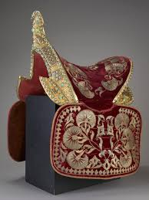
King’s saddle
Wiliam the Conqueror had governed England and Normandy by travelling from one place to another to make sure that his authority was accepted.
The kings were crowned in Westminister
But no centre for the government
The king’s household was the government, and but they were traveling a lot.
«The real capital of England was King’s saddle» (p.34)
To manage the increasing complexity of governance, English kings began delegating authority to
nobles and knights from the royal household to act as sheriffs in different regions.
These officials were responsible for enforcing
the king's laws, collecting taxes, and administering justice locally.
An administration centre which was much needed was established in Westminister. It checked the towns and the ports to make sure that taxes were paid, and kept a record of the fines made by the king’s court.
Official and written archive system was initiated and this led to the growth of bureaucracy. This bureaucratic structure facilitated the effective governance of the kingdom, allowing for more efficient management of resources and affairs.

Slide 3
Law and Justice
King was the law-maker and ultimate decision-maker.
In Saxon times, every district had had its own laws and customs, and justice had often been a family matter.
Henry I introduced the idea that all crimes, even those inside the family, were no longer only a family matter but a breaking of the king’s peace.
He appointed «Circuit Judges» They dealt with crimes and disagreements over property.
Traditional local laws were replaced by common law all over the land. «Common Law» The law administered by these travelling judges
Trial by Ordeal: Trial by ordeal was a legal practice where the accused person's guilt or innocence was determined by subjecting them to a physical test which was believed to be under divine intervention. The logic behind trial by ordeal was that if the accused were innocent, God would protect them from harm during the ordeal.
The accused person would be required to hold a hot iron on his tongue. After a certain period, typically three days, the wound would be examined. If the wound had healed cleanly, it was believed that God had intervened, indicating the person's innocence. However, if the wound did not heal properly, it was interpreted as a sign of guilt.
https://www.youtube.com/watch?v=ve2tbdvCdmc

Slide 4
Trial by Jury
In England trial by ordeal was replaced with trial by jury. The jury idea dated back to the Danes of Danelaw, but had only been used in disputes over land. Henry II had already introduced the use of juries for some cases in the second half of the twelfth century. But it was not the kind of jury we know today. In 1179 he allowed an accused man in certain cases to claim "trial by jury" . The man could choose twelve neighbours, "twelve good men and true» who would help him prove that he was not guilty. Slowly, during the later Middle Ages, the work of these juries gradually changed from giving evidence to judging the evidence of others.
Juries had no training in the law. They were ordinary people using ordinary common sense . It was soon obvious that they needed guidance. As a result law schools grew up during th e thirteenth cent ury, producing lawyers who could advise juries about the points of law.

Slide 5
Religious Belief
Power conflict between the king and the Church. The struggle was mainly for the following reasons:
Church's Assertion of Authority: The Church, particularly the Catholic Church, sought to establish itself as the supreme authority not only in spiritual matters but also in secular or earthly affairs. It argued for the doctrine of "spiritual supremacy," asserting that all individuals, including kings, were ultimately answerable to God and therefore subject to the authority of the Church.
Desire for Control: The Church desired control over both spiritual and temporal realms to ensure its influence over all aspects of society. This included matters such as law, governance, and the appointment of bishops and other clergy.
Monarchs' Response: Kings and monarchs, however, often resisted the Church's attempts to exert control over secular matters. They saw themselves as rulers ordained by divine right and were reluctant to give authority to the Church, particularly in matters concerning governance and the appointment of bishops.
Appointment of Bishops: One area of contention was the appointment of bishops. Kings sought to appoint bishops who would be loyal to them and support their political agenda. This allowed monarchs to influence the Church's hierarchy and ensure that bishops would prioritize the interests of the crown over those of the Church.
Conflict and Compromise: The struggle between the Church and monarchs often led to conflict and power struggles. However, there were also periods of compromise and cooperation, where both sides sought to balance their respective powers and interests

Slide 6
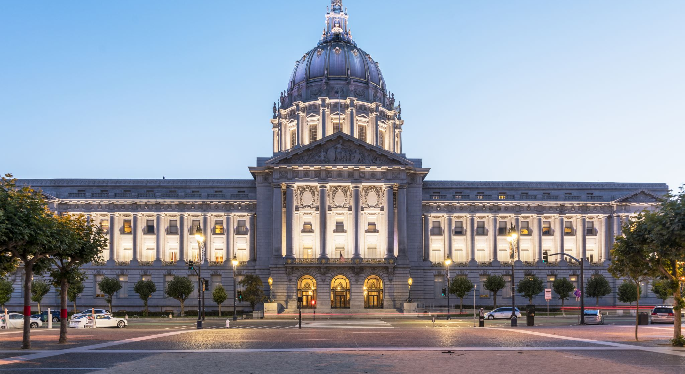
The Hiararchy
Deacons
Priests
Bishops
Archbishops
Cardinals
Pope

Slide 7
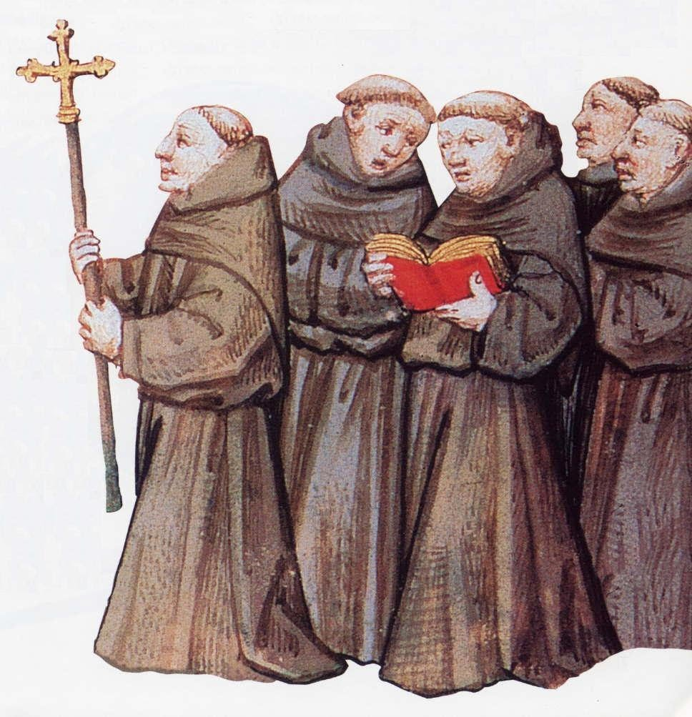
THE HOLY CATHOLIC CHURCH
The Friars: They were extra clergymen whose work was to look after the parishes (an ecclesiastical district) who had no priest of their own.
The friars in the «brotherhood» were wandering preachers.
From the website COMUNITATS DE CONEIXEMENT

Slide 8
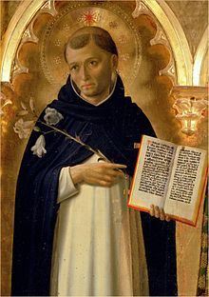
The two most important of all were the Franciscans (Grey Friars) and Dominicans (Black Friars)
These friars had their own “friaries” (branch offices)
Mendicant (begging) Friar: lives on what people gave them
From the website Wikipedia

Slide 9

The Cannons
helped to minister, to those who were without any other priest.
Those who lived strictly according to the rules of St. Augustine were called Augustinians.

Slide 10
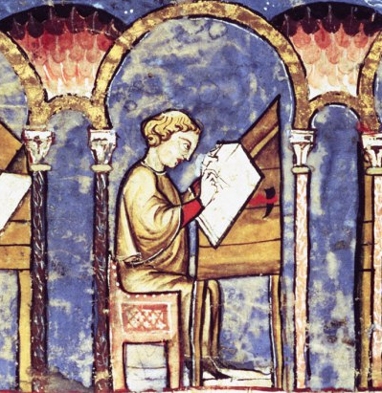
The Monks
From the website Dartmouth
were supposed to live strictly according to rule, and most of whom obeyed the rules of St. Benedict were known as Benedictines.
spent their time by copying books.
many wrote new chronicles – esp. chronicles

Slide 11
Ordinary people
Majority was serf and peasants.
Life in countryside was hard. Life was often harsh, with limited opportunities for social mobility and little protection from famine, disease, and conflict.
Shortage of food and price increases
Jewish Money lenders
Hatred for Norman rule (Robin Hood)

Slide 12
The Growth of towns as centres of wealth
Agricultural society, self-sufficient but needed things from abroad.
Trade/Import
Traveling traders, known as "chapmen" or "hucksters," played a crucial role in the wool trade. They would venture into rural areas and purchase wool directly from local producers at village markets. This direct exchange allowed rural communities to access markets beyond their immediate surroundings.
Transition from feudalism to town/city concept.
Charters of Freedom

Slide 13
Language Literature and Culture
Church Schools, Monasteries
Grammar Schools (Latin: language of education and church)
Oxford and Cambridge (the first universities)
French (language of law and the Norman rulers)

